Slide 1
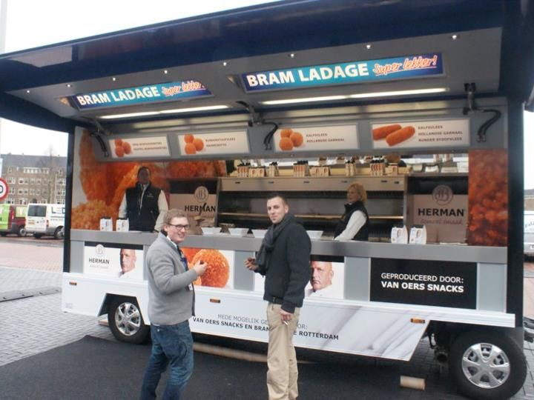

Capstone Project
Data Analysis: Snacks on Wheels - A mobile snack shop
Find Best Sales Spot

Slide 2
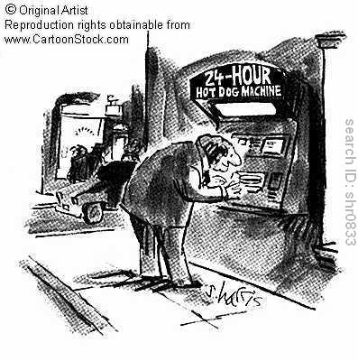
INTRODUCTION
An investor in New York , USA would like to start a new business “Snacks On Wheels”, a mobile snack shop.
This project provide data analysis support for “Snacks on wheels” business to decide the NEXT sales spot/location within the neighborhood of city of New York based some criteria
Notes:
There are calorie limits for snacks and sides, as well as entrees.

Slide 3


Constrains – Decide the sales spot based on …….
Top Trending Venue ( Expect restaurants )
Within 2000 meters from current location
Based on Venue Rating & Tips
Based on popular spots nearby
Nearest ( min distance) from current sales spots

Slide 4

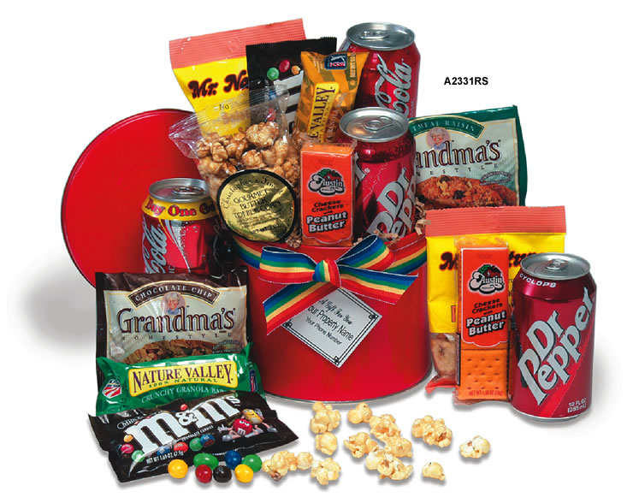
Data Used
New York neighborhood data from New York University spatial data repository
https://geo.nyu.edu/catalog/nyu_2451_34572
Foursquare data on Trending Venue, Venue Rating , Tips , Users , Nearby Location & Explore

Slide 5


Methodology Used
Statistical min() distance
Mean & Standard deviation
Haversine formula
FourSquare Trending Venue
Mean Venue Rating , Tips , User Details & Popular spots

Slide 6

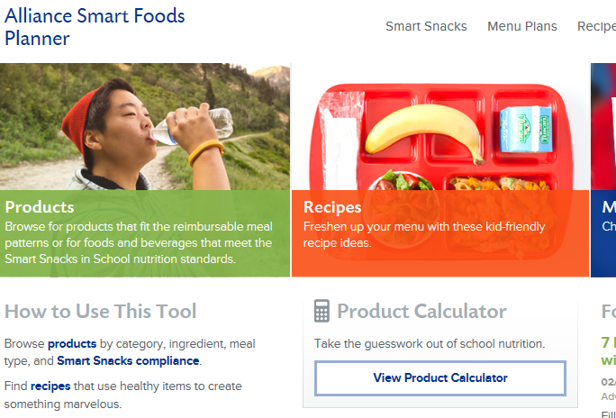
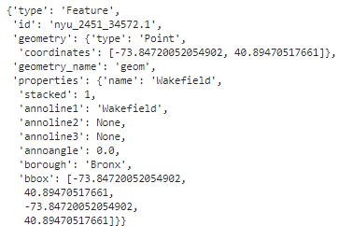
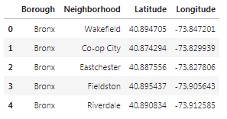
Results
Scrape the Wikipedia page , wrangle the data,
cleaned it, and then read it into a pandas dataframe
This data frame combined with Geospatial Data &
obtained the final data set.

Slide 7
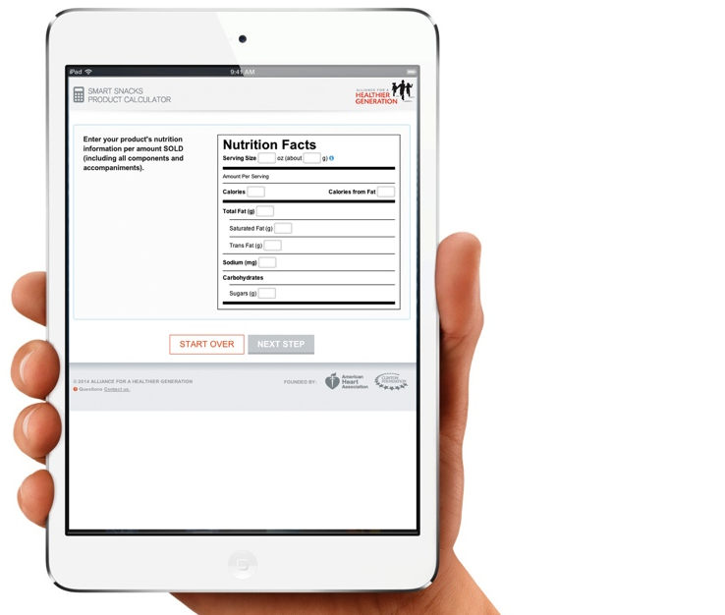
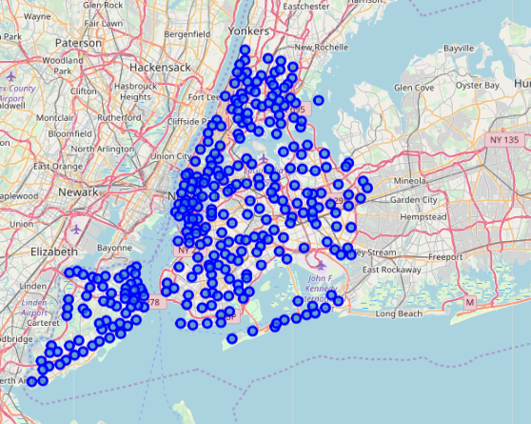
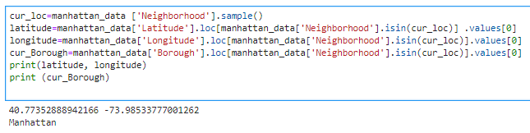
Results cont..
For testing, we randomly selected
a current location Geospatial Data
from the final data set and send to
foursquare API.
The return result from Foursquare
further filtered to satisfy the criteria
of exclude “restaurants” from
trending venue data set

Slide 8
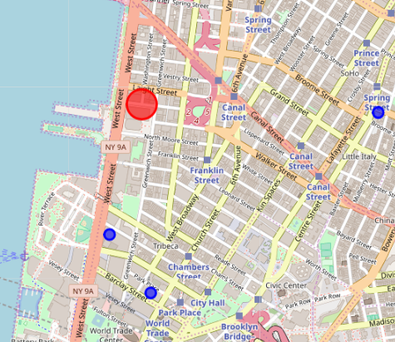
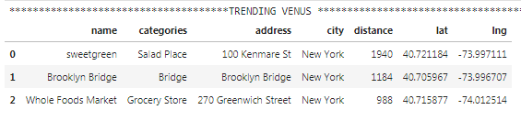
Results cont..
The Trending Venues after apply filter

Slide 9
Discussion
I
The statistical function min () is used to find the minimum distance trending venue and then it assigned as initial preferred venue for venue rating and tips analysis . This method shows positive results
The Venue Rating and Tips analysis provide very useful insight about the trending venues and user details gave an opportunity to chat with top rated user for more location information.
Filtering “Restaurants” helps to avoid false positives.
Exploring the venue further for ‘other popular spots nearby’ may help for risk management in the event of trending is incident based.

Slide 10
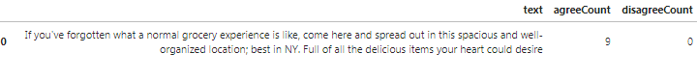
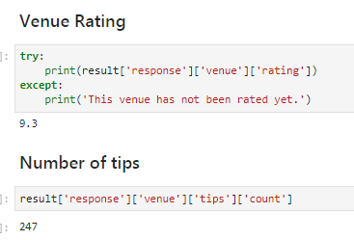
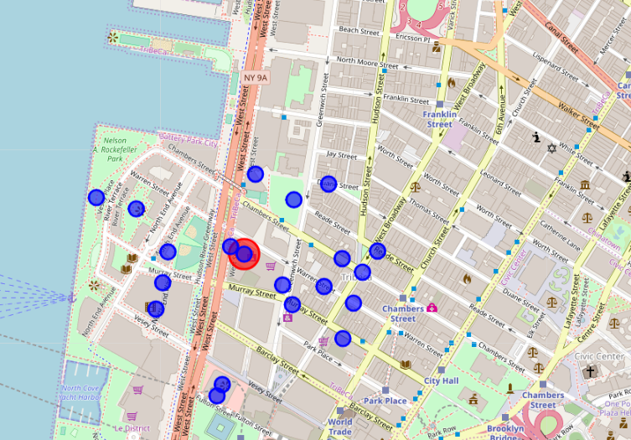
Trending Venues Nearby

Slide 11
Conclusion
Developed a data analysis platform which helps ‘Snacks on wheel’ mobile snack shop to find a best sales spot based on current location and FourSquare trending venue details
Venue Details analyzed further using venue rating , no of tips , tips details , etc.
Result presented to business owner alone with other ‘Popular spots nearby’ data.

Slide 12
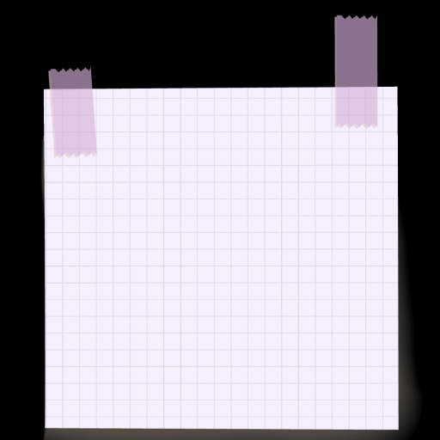


Limitations
Limited to
2000 M
around
Analyze
Only
50 Results
Filtering
Only
“restaurants”

Slide 13
References
Y. Li, M. Steiner, L. Wang, Z. Zhang and J. Bao, "Exploring venue popularity in foursquare," 2013 IEEE Conference on Computer Communications Workshops (INFOCOM WKSHPS), Turin, 2013, pp. 205-210. doi: 10.1109/INFCOMW.2013.6562896
X. Long, L. Jin and J. Joshi, "Understanding venue popularity in Foursquare," 9th IEEE International Conference on Collaborative Computing: Networking, Applications and Worksharing, Austin, TX, 2013, pp. 409-418.
Notes:
There are limits on sugar.

Slide 14

Questions ???
Email us : binejose@gmail.com

